Slide 1

Text Analytics
in R

Slide 2

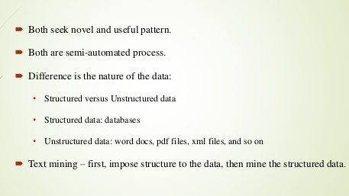

Slide 3
Applications of Text Analysis
Analytical sentiment analysis can replace more labor-intensive methods like polling.
Text analytics can also deal with the massive amounts of unstructured data being generated on the internet.
Computers are becoming more and more capable of interacting with humans and performing human tasks. IBM Watson, an impressive feat in the area of text analytics.
Enterprise Business Intelligence/Data Mining, Competitive Intelligence
E-Discovery Records Management
National Security / Intelligence
Scientific Discovery , especially Life Sciences
Sentiment Analysis Tools, Listening Platforms
Natural Language/Semantic Toolkit or Service
Publishing
Automated ad placement
Search/Information Access
Social Media monitoring

Slide 4
identification of a corpus is a preparatory step: collecting or identifying a set of textual materials
Preprocessing the text: Clean up Irregularities, Remove Punctuations, Remove Stopwords, Stemming, Rule-based algorithm (ed, ing, or ly)-Porter Stemmer
Bag of Words in R - to extract the word frequencies (IV) to be used in our prediction problem. Remove some terms that don't appear often – Sparse Terms.
make sure all of our words are appropriate variable name in the data frame
Sentiment Analysis &
Predictive Modeling
How can computers help?
The field that addresses how computers understand text is called Natural Language Processing.
The goal is to understand and derive meaning from human language.

Slide 5
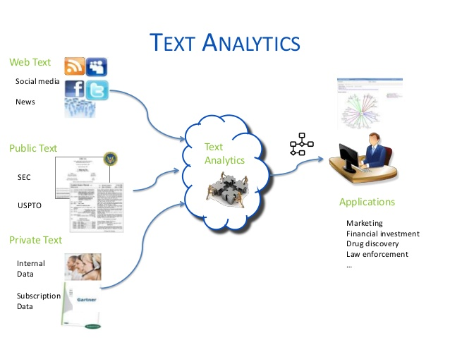
In this PPT we will see these two analysis

Slide 6
Analysis of Text Document

Slide 7
Data Set
We have seen data that are structured, numerical, or categorical.
On the other hand, tweets are loosely structured. They are often textual.
They have poor spelling, often contain non-traditional grammar, and they are multilingual.
Humans cannot, of course, keep up with internet-scale volumes of data
Even at the small scale, the cost and time required to process this is of course prohibitive.
How can computers help?
The field that addresses how computers understand text is called Natural Language Processing.
The goal is to understand and derive meaning from human language.

Slide 8
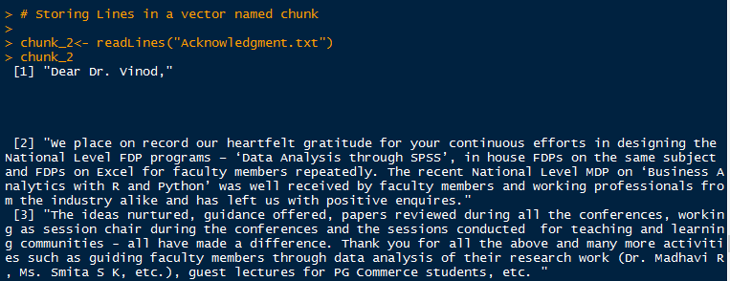
Import Text Document & store in a vector
Here we are taking an example of Text Document. Text file is available on the Github link given below:
Potdarjs/Text-Analytics/Acknowledgment.txt
Each Para is one index
Note - The data set is just for study purpose and should not be used anywhere or other purposes

Slide 9
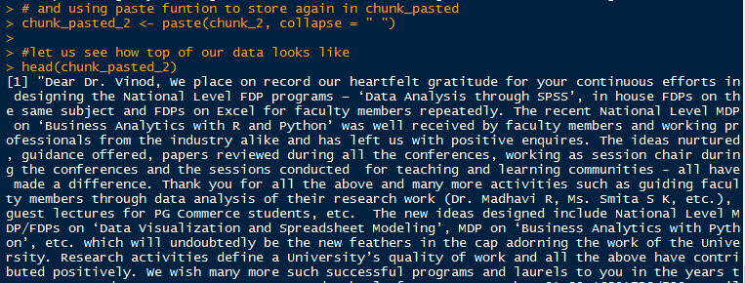
Convert to a single paragraph
Single index
Note - The data set is just for study purpose and should not be used anywhere or other purposes

Slide 10
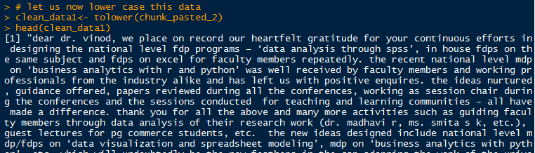
Convert entire text to lower case
Text is converted to lower case

Slide 11
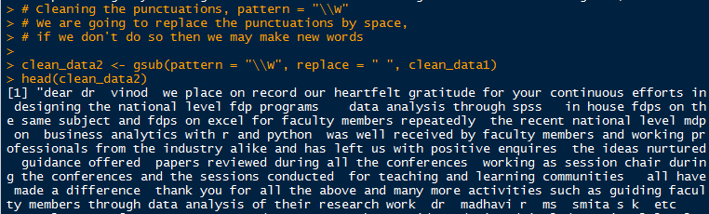
Remove Punctuation from the text
Punctuations are removed

Slide 12
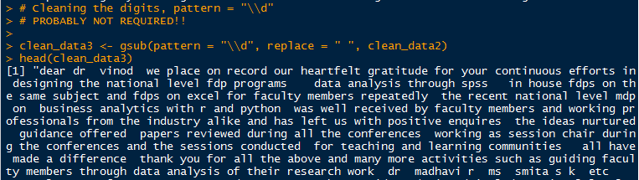
Remove Digits from the text
Digits are removed

Slide 13
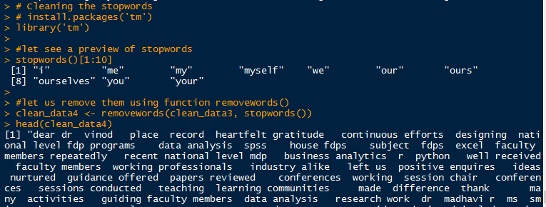
Remove ‘Stop Words’
Examples of ‘stop words’
‘stop words’ are removed

Slide 14
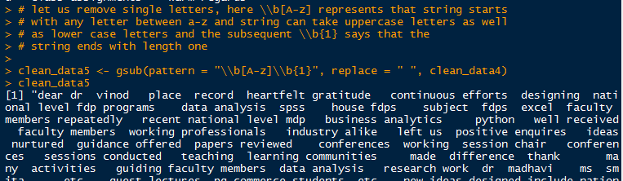
Remove letters
Letters are removed from the text

Slide 15
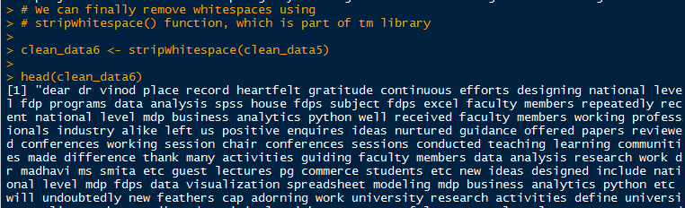
Remove White Spaces
White spaces are removed from the text

Slide 16
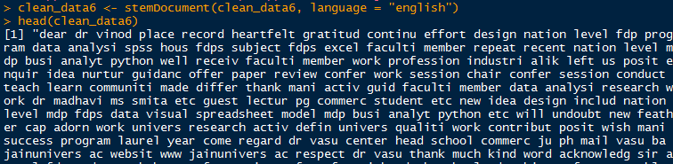
Stemming -
Porter Stemmer
Rule-based algorithm ‘ed’, ‘ing’, or ‘ly’ are removed

Slide 17
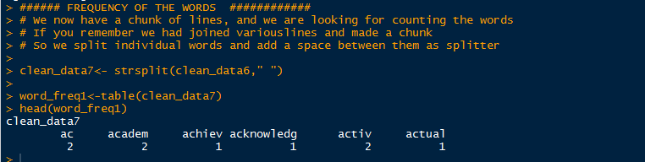
Create Frequency
Frequency

Slide 18
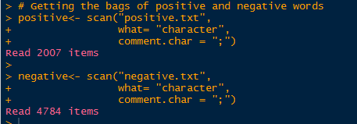
Getting the bags of Positive & Negative Words
Bag of Positive Words
Bag of Negative Words

Slide 19
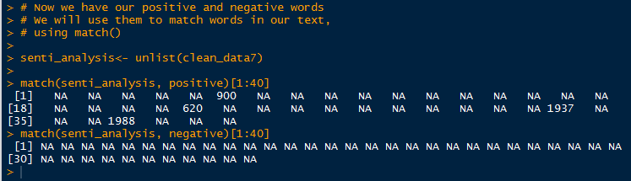
Sentiment Analysis – Match the Positive & Negative Words
We can see the output, place where it is matching, we have a number
This number is representing the position of the word in the list which matches

Slide 20
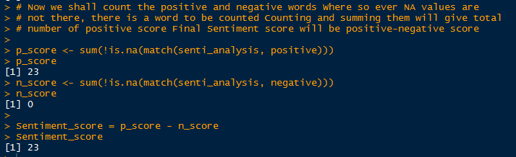
Sentiment Analysis – Positive Score , Negative Score & Sentiment Score

Slide 21
Analysis of Tweets and Building Prediction Model

Slide 22
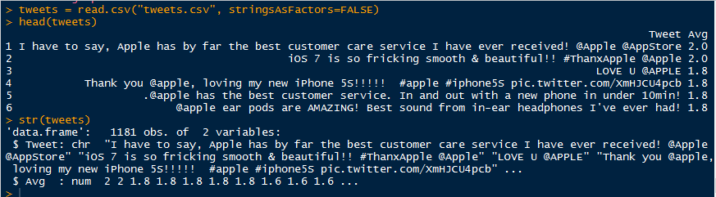
Import Data Set
Here we are taking an example of Tweets. Data file is available on the Github link given below:
Potdarjs/Text-Analytics/tweets.csv
First Column is tweets (text) and second column is average rating given by a team from -2 to 2.
Note - The data set is just for study purpose and should not be used anywhere or other purposes

Slide 23
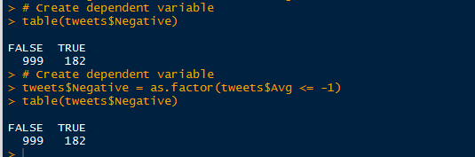
Preprocessing – Create Target Variable

Slide 24

Required Packages
Install new packages “tm” & “SnowballC” and call in library

Slide 25
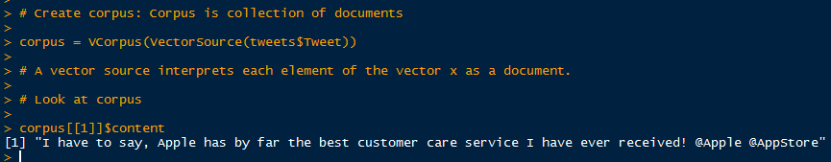
Create Corpus

Slide 26
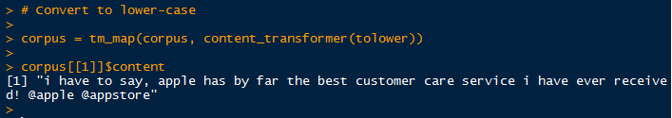
Convert entire text to lower case
Text is converted to lower case

Slide 27
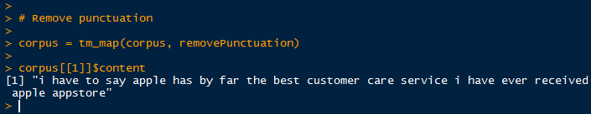
Remove Punctuation from the text
Punctuations are removed

Slide 28
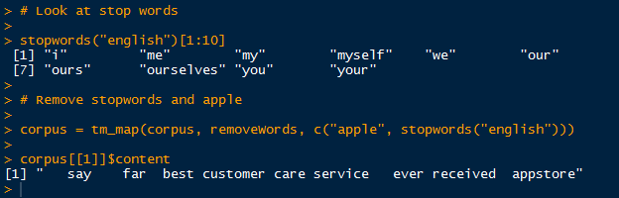
Remove ‘Stop Words’ and word ‘Apple’
Examples of ‘stop words’
‘stop words’ & word ‘apple’ are removed

Slide 29
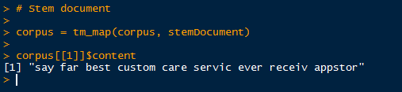
Stemming -
Porter Stemmer
Rule-based algorithm ‘ed’, ‘ing’, or ‘ly’ are removed

Slide 30
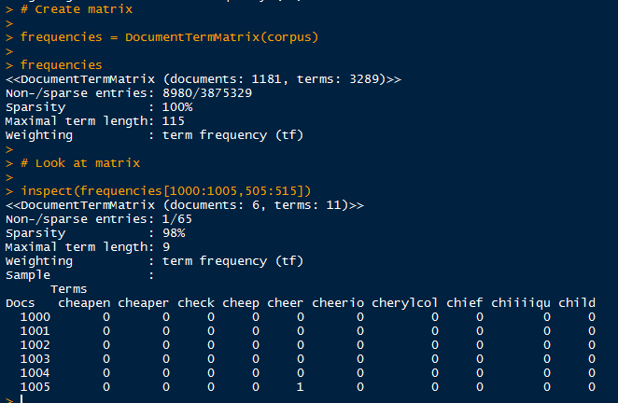
Create Frequency Matrix
3289 terms generated
Frequency Matrix

Slide 31
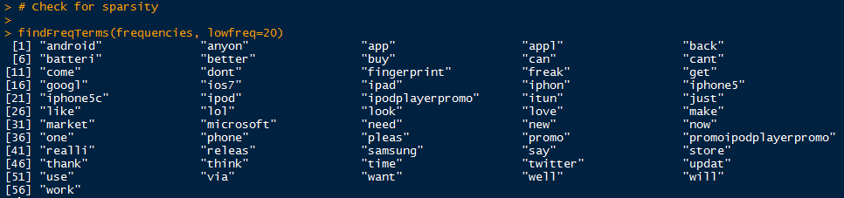
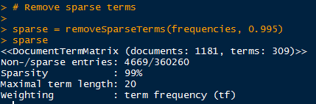
Check for Sparsity & remove it
Low Frequency Words
Remove Spartsity
Only 309 terms remained

Slide 32
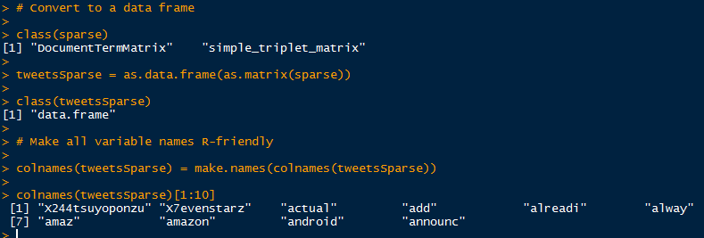
Convert to Data Frame & Make Correct Column Names
Converted to Data Frame
Correct Column Names

Slide 33
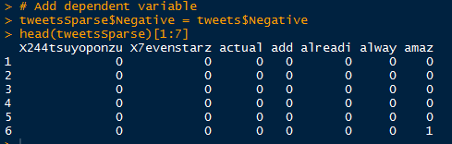
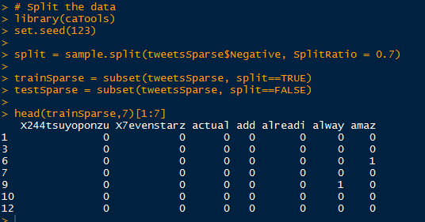
Add Dependent Variable & Split the Data
Dependent Variable ‘Negative’ added
Split Data for Training and Test

Slide 34
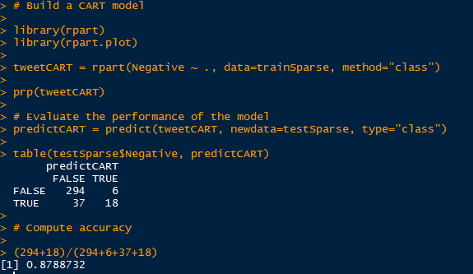
Build CART Model, Predictions & Accuracy
CART Model
Predictions
Accuracy of Model

Slide 35
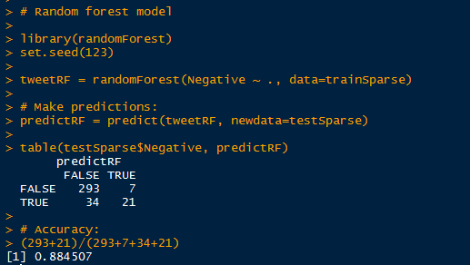
Build Random Forest Model, Predictions & Accuracy
RF Model
Predictions
Accuracy of Model

Slide 36
Word Cloud

Slide 37
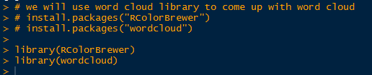
Install Package & Call in library

Slide 38
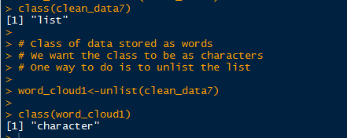
The word data should be character form

Slide 39
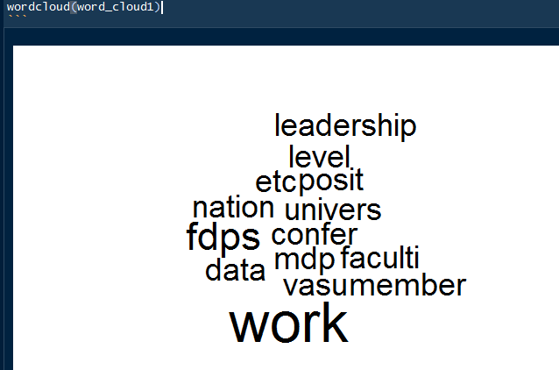
Word Cloud – Raw Form

Slide 40

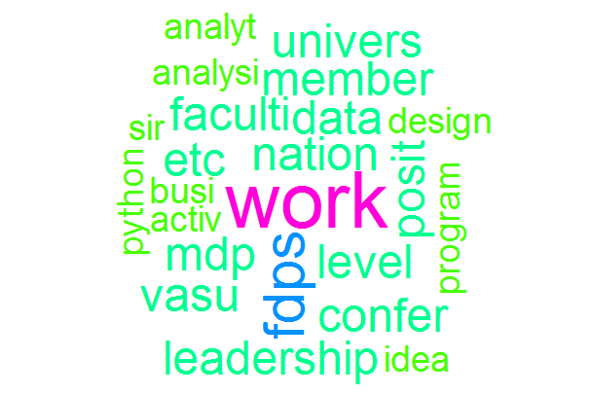
Word Cloud – Add Color, Scale, Frequency, Order

